Slide 1
Module 1: Introduction to game programming
Module 1 contents:
Game Architecture
Applying the Game Architecture
Application Layer
Game Logic
Game View for the Human Player
Game Views for AI Agents
Networked Game Architecture
Design Philosophy of DirectX

Slide 2
What is Game Programming?
Programming games can be very different from other kinds of programming.
Game programming refers to the code that brings a video or computer game to life.
As technology has evolved, so has programming. Early on in video game history, programmers were often responsible for most aspects of development, including design. But as hardware and software improved, and games became increasingly more complex, dev teams grew dramatically.

Slide 3
What is Game Programming?
everybody loves games.
You get to play with some great technology from manufacturers like Nintendo, Microsoft, Sony, Apple, and others.
Software development kits from companies like Unity, Havok , Epic, Valve, and others are also a lot of fun to play with.

Slide 4
What is Game Programming?
There are tons of reasons programmers get attracted to games: graphics, physics, AI, networking, and more.
Looking at all of the awesome games that have been released over the past few years, such as Halo, Grand Theft Auto, Gears of War, and other, all are based in the area of graphics or physics programming.

Slide 5
Game Architecture
There are as many ways to assemble the subsystems of a game as there are game
programmers.
You can take every subsystem in a game and classify it as belonging to one of three primary categories: the application layer, the game logic layer, and the game view layer .
The application layer deals with the hardware and the operating system. The game logic layer manages your game state and how it changes over time. The game view layer presents the game state with graphics and sound.

Slide 6
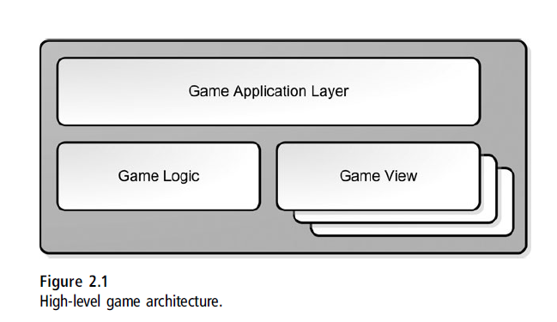
Game Architecture

Slide 7
Game Architecture
Another popular design pattern, the Model-View-Controller, seeks to separate the logic of a system from the interface used to present or request changes to data.
The architecture that is proposed encapsulates and adds a layer for hardware or operating system–specific subsystems.
The application layer concerns itself with the machine your game runs on. If you were going to port your game from Windows to iOS or Android, or from the PlayStation 3 to Xbox 360, you would rewrite most of the code in the application layer, but hopefully not much else.

Slide 8
Game Architecture
The game logic layer is your game, completely separated from the machine your game runs on or how it is presented to the player.
You could simply recompile all the source code related to your game logic, and it would run on any platform or operating system.
In this area, you’ll find subsystems for managing your game’s world state, communicating state changes to other systems, and accepting input commands from other systems.
You’ll also find systems that enforce rules of your game system’s universe. A good example of this is a physics system, which is the authority on how game objects move and interact.

Slide 9
Game Architecture
The third and last system component is the game view. This system is responsible for presenting the game state and translating input into game commands that are then sent to the game logic.
The interesting thing about the game view is that it can have different implementations, and you can have as many views attached to your game as your computer can handle.
One type of game view is for your players; it draws the game state on the screen, sends audio to the speakers, and accepts input through the user interface.
Another type is the view for the artificial intelligence (AI) agent, and a third might be a view for a remote player over a network. They all get the same state changes from the game logic—they just do different things.

Slide 10
Applying the Game Architecture
The code for the AI would communicate through the same pathways and in exactly the same manner as a human being.
For e.g. Let’s design a racing game using the game logic and game view architecture, and we’ll also create two views: one for a human player and one for an AI driver who will race with you on the track.
The game logic for a racing game will have the data that describes cars and tracks and all the minute properties of each. For the car, you’ll have data that describes how weight is distributed, engine performance, tire performance, fuel efficiency, and things like that.

Slide 11
Applying the Game Architecture
The track will have data that describes its shape and the properties of the surface all along the route. You’ll also have a physics system that can calculate what happens to cars in various states of acceleration and steering, how they respond to the track, change in input controls, or even collisions with each other.

Slide 12
Applying the Game Architecture
For inputs, the game logic cares about only four things for each car: steering, acceleration, braking and perhaps the emergency brake. If your cars have guns on them, like we all wish, you would also have an input for whether the fire trigger is down. The game logic needs nothing else as input to get the cars moving around the track.
Outputs from the game logic will be state changes and events. This includes each car’s position and orientation and the position and orientation of the wheels in relation to the car’s body.

Slide 13
Applying the Game Architecture
If the game supports damage, you’ll also have damage statistics as an output. If your cars have guns, a state change could also be whether the weapon is firing and how much ammo is left.
Another important game state, is collision events. Every time a collision happens, the game logic sends an event with all the collision data. Events and state changes are sent to game views.

Slide 14
Applying the Game Architecture
The game view for the human has a lot of work to do to present the view of the game state.
It has to draw the scene from the player’s selected point of view, send audio to the speakers, spawn particle effects—especially when bad drivers are scraping down the guardrails—and rumble the force feedback controls. The view also reads the state of the game controller and translates that into game logic commands.
A good example of this is to notice the right trigger pressed to full throttle, and it sends the “Accelerator at 100%” command to the game view or changes in the left thumbstick to “Steer left at 50%.” These commands are sent back to the game
logic.

Slide 15
Applying the Game Architecture

Slide 16
Applying the Game Architecture
Imagine what happens when a player mashes the A button on the controller—the normal control for the emergency brake in Xbox 360 racing game. The human view interprets this as a request to hit the emergency brake on Ferrari and sends a message to the game logic. The game logic evaluates the request, sets m_bIsEmergencyBrakeOn to true, and sends a state update back to the human view.
The human view responds to this message by playing a sound effect or maybe showing something on the screen. Another example is the throttle setting. The controller sends a message to the game view that the right trigger is pressed 82%.

Slide 17
Applying the Game Architecture
The view interprets this as a command to set the accelerator to 82% and sends a request to the game logic. The game logic determines that the rear tires have broken loose by looking at the car, its weight, the tires, the track condition, and other factors. It sends a message back to the game view that the rear tires are spinning, and the game view can then respond by playing a sound effect.

Slide 18
Applying the Game Architecture
You can see that the game controller’s thumbstick or button state doesn’t affect the game state directly.
Instead, the controller’s state is interpreted by the game view and converted into commands, which are sent to the game logic by an event.
The game logic receives events generated by the view and uses those commands, along with its physics simulation, to figure out what is happening in the game universe.
The state changes in the game world get sent back to the view, so it can draw polygons, play sound effects, and rumble the controller.

Slide 19
Applying the Game Architecture
The game view for the AI is a little different.
It will receive the same game state events received by the human game view, such as which track the race is occurring on, the weather conditions, and the constantly updated positions, orientations, and velocity of cars on the track. It will take this information and recalculate what commands to send into the game logic.
For example, in response to the “Go” event from the game logic, the AI might send an “Accelerator at 100%” command back to the game logic. While negotiating a turn, it might send “Steer left at 50%” to the game logic.

Slide 20
Applying the Game Architecture
The inputs to the game view, namely the game status and game events, are exactly the same.
Game architecture is flexible, game logic can have any number of views, both human and AI.
If the interfaces for the human and AI views are exactly the same, it is a trivial matter to swap a human player, or even all human players, with AI players.

Slide 21
Applying the Game Architecture
You could create a special DVR game view which record game events into a buffer and play them back.
The game logic is entirely short circuited , but since the game state changes and events are exactly the same, they can be presented in the DVR view with very little recoding. Of course, if you want a “rewind” feature, you’ve got some extra work to do because the game events don’t necessarily go equally back in time as they go forward!

Slide 22
Applying the Game Architecture
You could also create a special game view that forwards game status and events to a remote player across the Internet.
Think about that: The game logic doesn’t have to care whether the players are local or separated by thousands of miles.
The remote view should be pretty smart about collecting game states and events, compressing them into as few bytes as possible, and shipping them via TCP or UDP to the remote player.
The game commands received from the remote player should go through a verification filter. You can never be too sure about remote players, or remote game logics, for that matter.

Slide 23
Applying the Game Architecture
Players with different views can be advantaged or disadvantaged.
For example, those who play on 4:3 screens can’t see quite as much as those playing on 16:9 screens.

Slide 24
Application Layer
The contents of the application layer are divided further into different areas that deal with devices, the operating system, and your game’s lifetime.

Slide 25
Application layer
Reading input:
Games have an amazing variety of user input devices: keyboard, mouse, gamepad, joystick, dance pad, steering wheel, cameras, accelerometers, GPS, and the guitar.
Reading these devices is almost always completely dependent on calls to the operating system and device drivers.

Slide 26
Application layer
Reading input:
The state of these devices should always be translated into game commands.
Some of these commands might be sent back to the game logic, such as “fire missile,” while others might be handled by the game view, such as “show me my inventory.”
Either way, you’ll likely write an entire subsystem to read these devices and interpret them as commands.

Slide 27
Application layer
Reading input:
The state of these devices should always be translated into game commands.
Some of these commands might be sent back to the game logic, such as “fire missile,” while others might be handled by the game view, such as “show me my inventory.”
Either way, you’ll likely write an entire subsystem to read these devices and interpret them as commands.

Slide 28
Application layer
Reading input:
This same system should also be configurable.
If you have a system that reads devices as input and sends game commands as output, you can create the system to read a configuration file to match controls with commands.
Then all you have to do is modify this data file, and you’ll have completely configurable controls.
One thing is critical: You can’t simply change the game state directly when you read user input.

Slide 29
Application layer
File Systems and Resource Caching:
File systems read from and write data to storage systems such as DVD-ROM, hard disk, and SD cards.
Code in this subsystem will generally be responsible for managing game resource files and loading and saving the game state.
Managing resource files can be pretty complicated.
Resource cache is one of those hidden systems.

Slide 30
Application layer
File Systems and Resource Caching:
Need of a resource cache
Imagine the problem of getting a crowd of people out of a burning building. Left to their own devices, the crowd will panic, attempt to force themselves through every available exit, and only a small fraction of the people will escape alive.
Now imagine another scenario, where the evacuation is completely organized. The crowd would divide themselves into single file lines, each line going out the nearest exit. If the lines don’t cross, people could almost run. It would be very likely that even a large building could be completely evacuated.

Slide 31
Application layer
File Systems and Resource Caching:
This analogy also works well for game resources. The burning building is your slow optical media, and the doors are the limited bandwidth you have for streaming this media.
The bits in your resource file represent the crowd. Your job is to figure out a way to get as many of the bits from the optical media into memory in the shortest possible time. That’s not the entire problem, though. A resource cache is exactly what the name implies—commonly used assets like the graphics for the HUD are always in memory, and rarely used assets like the cinematic endgame are only in memory while it’s playing, and most likely only a piece of it at that.

Slide 32
Application layer
Managing Memory:
Managing memory is a critical system for games.
Simply put, the default memory manager that comes with the default C-runtime libraries is completely unsuitable for most game applications.
Many game data structures are relatively tiny things, and they belong in different areas of memory, such as RAM or video memory.
A general memory manager tries to be all things to all applications, where you will know every detail about how your game needs and uses memory. Generally, you’ll write your own memory manager to handle allocations of various sizes and persistence and more importantly to track budgets.

Slide 33
Application layer
Initialization, the Main Loop, and Shutdown:
Most software waits for the user to do something before any code is executed. If the mouse isn’t moving and the keyboard isn’t being hammered, an application like Microsoft Excel is completely idle.
This is good because you can have a bunch of applications up and running without a large CPU overhead. Games are completely different.
Games are simulations that have a life of their own. Without player input, they’ll happily send some horrific creature over to start pounding on your character’s
skull.

Slide 34
Application layer
Initialization, the Main Loop, and Shutdown:
That will probably motivate a few button presses.
The system that controls this ongoing activity is the main loop, and it has three major components: grabbing and queuing player input, ticking the game logic, and
presenting the game state to all the game views, which means rendering the screen, playing sounds, or sending game state changes over the Internet.
At the highest level, your game application layer creates and loads your game logic, creates and attaches game views to that logic, and then gives all these systems some CPU time so they can do their jobs.

Slide 35
Application layer
Other Application Layer Code
There are lots of other important subsystems in the application layer, including the following:
The system clock
String handling
Dynamically loaded libraries (DLLs)
Threads and thread synchronization
Network communications
Initialization
Main loop
Shutdown

Slide 36
Game Logic
The game logic is the heart and soul of your game.
It defines the game universe, what things are in the universe, and how they interact.
It also defines how the game state can be changed by external stimulus, such as a human player pressing a gamepad key or an AI process taking action to kill you.
Let’s take a closer look at all of the components of the game logic system.

Slide 37
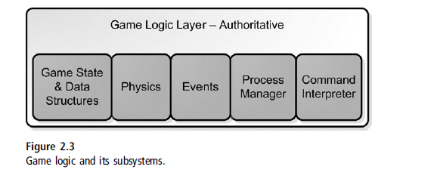
Game Logic

Slide 38
Game Logic
Game State and Data Structures:
Every game will have a container for game objects.
Simple games can use a list structure, but more complicated games will need something more flexible and optimized for quick local searching or streaming.
Your game engine must be able to traverse the object data structures quickly to change an object’s state, and yet it must be able to hold a flexible array of properties for each object.
These two requirements are frequently at odds with each other; one is quick to search, the other is easy to extend.

Slide 39
Game Logic
Game State and Data Structures:
Ultima used a simple two-dimensional array of object lists.
It was easy to find objects within a given range of a map location, and each grid square was small enough to have a quickly traversable list of objects.
Thief: Deadly Shadows, on the other hand, used a simple list of objects, but it was heavily tangled by internal pointers.
If two objects needed to know about each other, such as an elevator button and the elevator door, they were linked by the game editor. This solution is commonly used.

Slide 40
Game Logic
Game State and Data Structures:
Object properties, such as hit points, engine horsepower, and wacky things like that tend to be stored in custom data structures.
Ultima Online used text strings to define properties on objects, which had the benefit of easy and flexible development at some cost in memory storage.

Slide 41
Game Logic
Game State and Data Structures:
Thief: Deadly Shadows had an extremely complicated property system that was actually object oriented; you could define object properties for an archetype, like a barrel, but overload existing properties or even create totally new ones for a particular barrel that was placed only once in the game universe.
The system was memory efficient since it never copied property data, but it ran at some extra cost in CPU time because the property system was essentially a tree structure. There are tradeoffs no matter how you do it.

Slide 42
Game Logic
Game State and Data Structures:
It’s easy to confuse the game logic representation of an object with the visual representation of an object.
The game logic holds the object state, such as the amount of damage an object has -probably stored in an integer.
The visual representation, managed by the game view, holds model data and textures that convey the state visually to the player, such as a bloody arm stump.
A bloody arm stump texture is completely different from m_damage = 30.

Slide 43
Game Logic
Game State and Data Structures:
You might feel that it would be better to store all of these things in a single C++ object.
Most modern games create special objects that contain all of the various definitions that make that game object unique.
Some of the classes in the collection belong to the game view, such as the skeletal mesh object used by the renderer to display the actor.
Others might belong to the game logic, such as data that tells the physics system how heavy the actor is and how it will collide with other physical objects in the game..

Slide 44
Game Logic
Game State and Data Structures:
Other objects might describe game specific data, such as a character’s hit points; this too would belong to the game logic.
When any game logic data changes, the game logic broadcasts an event.
In the previous example, when damage is increased on the actor, the game logic sends a special event informing all of the game subsystems . The renderer reacts to this event by changing the texture.

Slide 45
Game Logic
Physics and Collision:
Physics falls under the general category of “rules of your game universe” and is solidly a member of your game logic.
It defines everything from how actors move when they fall under gravity to what they do when they tumble around and come into contact with other actors.

Slide 46
Game Logic
Events:
When the game logic makes changes in the game state, such as creating or moving an actor, a number of game systems will respond.
Here’s an example. Imagine that one actor in your game is a portable radio. The graphics system will need to create polygons and textures so you can see the radio.
The sound system will create a sound effect so your radio will play some great music—perhaps a little Jimi Hendrix. AI processes might respond to the presence of the actor.

Slide 47
Game Logic
Events:
All three of these subsystems the graphics system, the audio system, and even the AI system need to know that this radio exists and what it is doing. These systems are notified through events.
Just like a Windows application hears about a WM_MOUSEMOVE event, your game systems can listen and react to a game event for practically any change in game state or input from a player. There are also global game events, such as events to inform subsystems that a new level has been loaded or the game is being saved.

Slide 48
Game Logic
Events:
Many games create an event system that defines these events and the data that accompanies them.
Different subsystems register with the Event Manager to listen for events that they’ll react to.
A good example of this is the sound system; it might register to listen for object collision events so that it can play the appropriate sound effect when two objects are smashed together.

Slide 49
Game Logic
Process Manager:
This is the heart of another important game subsystem: the Process Manager.
It keeps a list of processes and gives each one a little CPU time by calling it once every game loop.
A great example of this is a path find process.
It acts to move an actor from one place to another, and when the destination is reached, it simply terminates and ceases acting on the actor.

Slide 50
Game Logic
Process Manager:
On Ultima, we found it very useful to allow processes to have dependencies on one another, where one process would wait for another to complete before starting.
A good example of this is something you might use for a Molotov cocktail: One process tracks the parabolic movement of any game object until it collides with something, and another process manages a fireball explosion.
Your game can string these processes together to create some amazingly cool effects.

Slide 51
Game Logic
Command Interpreter:
A game logic needs to respond to external commands.
For a human playing a racing game, these commands will send input to the game logic’s representation of the car: acceleration, braking, and steering.
An AI process will do exactly the same thing.
External entities, such as a human holding a gamepad or an AI process using a command-based interface, can communicate to the game logic with exactly the same commands.

Slide 52
Game Logic
Command Interpreter:
In any racing game, there should be someplace in the code that says “If button A is down, set emergency brake” or something like that.
It seems like a lot of extra work, but that breaks the separation between game logic and game views that I have found to be so important when creating games.

Slide 53
Game Logic
Command Interpreter:
What should happen is this: The game view presents an interface to the human player that changes the “Button A is pressed” state into a game command, “Set Emergency Brake.”
That game command is then sent to the game logic, but here’s the rub: The code that actually sets the emergency brake state on the data structure representing the car is actually in the game logic.
This code only sets the emergency brake in response to a command—not through a direct tweak to the m_bIsEmergencyBrakeOn member of a class somewhere.

Slide 54
Game View for the Human Player
A game view is a collection of systems that communicates with the game logic to present the game to a particular kind of observer.
This observer can be a human being with a controller of some kind, like a keyboard or a plastic drum set, but it can also be an AI agent, whose view of the game state will determine the AI process’s next course of action.
The game view for a human being has a lot of work to do It must respond to game events and figure out how to draw the scene, send output to the speakers, translate controller input into game commands, and more.
Let’s look at the main areas.

Slide 55
Game View for the Human Player
Graphics Display:
A The display renders the objects that make up a game scene, the user interface layer on top of the scene, and perhaps even streaming video. The renderer should draw the screen as fast as it possibly can.
The display can be one of the biggest suckers of CPU budget in a game and should therefore scale well with the capabilities of a wide range of CPUs and GPUs (graphic processing units).

Slide 56
Game View for the Human Player
Graphics Display:
For PC or handheld games, it should also perform well under different hardware configurations and operating system releases.
Generally, the game engine will disable expensive but nonessential features, such as full screen effects, in order to run at the best frame rate they can.

Slide 57
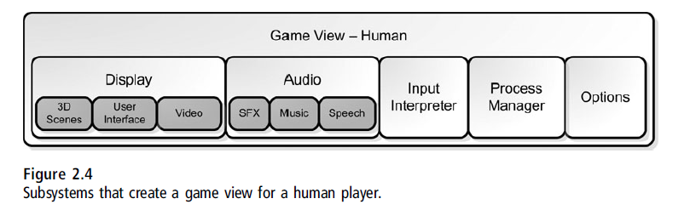
Game View for the Human Player
Graphics Display:

Slide 58
Game View for the Human Player
Graphics Display:
Video cards will draw all the polygons you stuff into the GPU, even if it takes them more than 50ms, giving you a frame rate of 20fps, even if that’s all your game does.
The real problem a 3D engine has is choosing which polygons to draw to make the most compelling scene.

Slide 59
Game View for the Human Player
Graphics Display:
Video cards will draw all the polygons you stuff into the GPU, even if it takes them more than 50ms, giving you a frame rate of 20fps, even if that’s all your game does.
The real problem a 3D engine has is choosing which polygons to draw to make the most compelling scene.
Eg. Microsoft Flight Simulator X

Slide 60
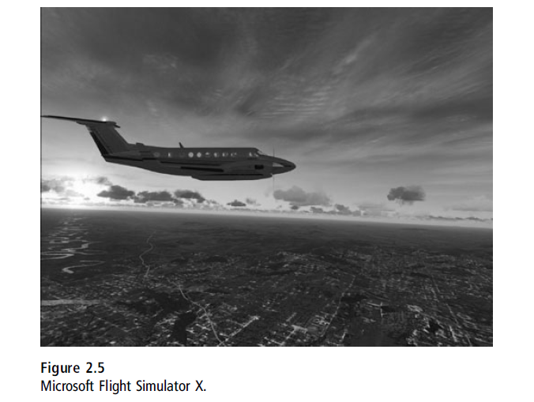
Game View for the Human Player
Graphics Display:

Slide 61
Game View for the Human Player
Audio:
Game audio can generally be split up into three major areas: sound effects, music, and speech.
Sound effects are pretty easy things to get running in a game.
You simply load a WAV file and send it into DirectX with volume and looping parameters.
Almost every sound system is capable of simulating the 3D position of the object relative to the listener.
You just provide the position of the object, and the 3D sound system will do the rest.

Slide 62
Game View for the Human Player
Audio:
Music can be really easy or really hard.
Technically, it’s not really different from sound effects unless you want to get into complicated mixing of different tunes to reflect what’s going on in the game.
Anyone who’s played Halo knows how effective this can be; the distinctive combat music tells you you’d better reload your shotgun.

Slide 63
Game View for the Human Player
Audio:
Speech is much trickier—not just technically, but keeping track of all the bits and pieces recorded in the studio and matching them with a 3D lip-synched character.
This usually involves anything from a total hack to a carefully hand-tweaked database of mout positions for each speech file to a tool that can automatically generate this data.

Slide 64
Game View for the Human Player
User Interface Presentation:
The user interface for a game doesn’t look like something drawn by the Windows GDI.
Game interfaces have a creative flair, and they should.
This means that the user interface needs to be baked fresh every time, especially since every health meter and HUD are different for every game.

Slide 65
Game View for the Human Player
User Interface Presentation:
Games need things like a button control, so players can easily click OK for whatever thing the game is asking about.
These controls aren’t hard to write, but you have to rewrite something that already exists
Another option is licensing Iggy from RAD Game Tools or Scale-Form GFx, which lets your artists create your entire UI in Flash and import the results directly into your game.

Slide 66
Game View for the Human Player
Process Manager:
Same as game logic.
It turns out that game views can use their own process manager to handle everything from button animations to streaming audio and video.

Slide 67
Game View for the Human Player
Options:
Most games have some user-configurable options like sound effects volume, whether your controls are Y-inverted or not, and whether you like to run your game in 4:3 or in 16:9 widescreen.
These options are useful to stick in something simple like an XML file so that anyone can easily tweak them, especially during development.

Slide 68
Game View for the Human Player
Multiplayer Games:
One thing you might not have considered—this event-based, logic/view architecture makes it simple to have a multiplayer game.
All you need to do is attach more human views to the same game logic.
It’s a little more trouble than that because each view needs to share what is likely a single display from the application layer, figure out how to iterate the additional controls, and so on.
This is easy compared to getting the overall architecture built to support multiple players, especially if it wasn’t designed to do so from the very beginning.

Slide 69
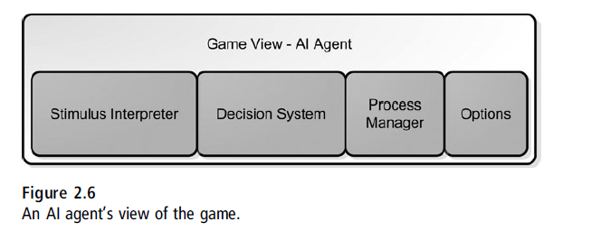
Game Views for AI Agents
The similarity between game logic and game views is that humans and AI processes can interact with the game logic through exactly the same event-based interface. An AI agent’s view of a game generally has the components shown in Figure

Slide 70
Game Views for AI Agents
The stimulus interpreter receives the same events that all other game views receive: object movement, collisions, and so on.
It’s up to the AI programmer to determine how the AI will react to each event the AI agent receives.

Slide 71
Game Views for AI Agents
It would be easy enough for an AI process to ignore certain events or react to events that are filtered by the human view, and this would certainly affect what the AI process would do.

Slide 72
Game Views for AI Agents
For example, AI agents might react to sound effects, which are the result of game events such as objects colliding, footsteps, or noisy objects like radios being activated.
If an AI is supposed to be deaf, it merely filters the sound events.

Slide 73
Game Views for AI Agents
If an AI is supposed to be blind, it filters any event about the visible state of an object.
You can set the nature of an AI agent’s behavior completely by controlling what stimuli the AI agent receives.

Slide 74
Game Views for AI Agents
The second part of an AI view is the decision system.
This is a completely custom written subsystem that translates stimuli into actions.

Slide 75
Game Views for AI Agents
If your AI needs to solve difficult problems, such as how to navigate a complicated environment or make the next move in a chess match, then you might need a process manager just as in the game logic and game view.

Slide 76
Game Views for AI Agents
Finally, you’ll certainly want a list of AI options that you can tweak through a simple text file.

Slide 77
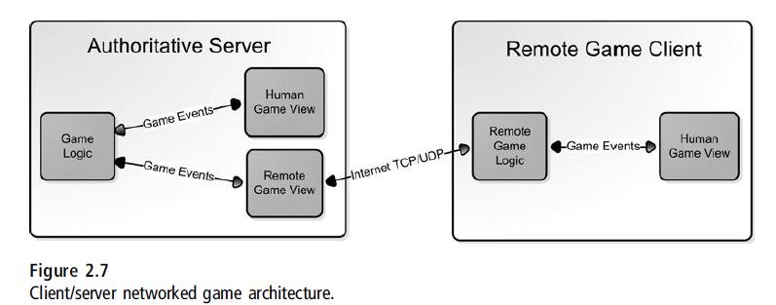
Networked Game Architecture
If you implement the game architecture you can write two additional classes and transform your single-player game into a networked, multiplayer game.

Slide 78
Networked Game Architecture
You see the same game logic/game view architecture, but there is a new implementation
of the game logic and a new implementation of the game view.
Both are needed to create remote versions of their single-player.

Slide 79
Networked Game Architecture
Remote Game View:
On the server machine, the remote player should appear just like an AI agent.
The remote view receives game events from the game logic and responds with commands back to the game logic.
What happens inside the remote view is completely different from the AI agent view or the human view.

Slide 80
Networked Game Architecture
Remote Game View:
Game events received from the game logic are packaged up and sent via TCP or UDP to a client computer across the network.
Since game events on a local machine can be somewhat bloated, there should be some processing of the event data before it is sent out.
First, redundant messages should be removed from the message stream.
It makes no sense to send two “Object Move” events when the only one that matters is the last one.

Slide 81
Networked Game Architecture
Remote Game View:
Second, multiple events should be sent together as one packet. If the packet is large enough, it should be compressed to save bandwidth.
The remote game view also receives IP traffic from the remote machine, namely the game commands that result from the controller input.
One difference in the remote game view is that it should never trust this command data entirely.

Slide 82
Networked Game Architecture
Remote Game View:
The game logic should be smart enough to do some sanity checking on impossible commands, but the remote view can take a front-line approach and attempt to short-circuit any hacking attempts, such as detecting badly formed packets or packets that come in with an unusual frequency.
Once the game commands have gone through some kind of anti-hacking filter, they are sent on to the game logic.

Slide 83
Networked Game Architecture
Remote Game Logic:
In this model, the game logic is an authoritative server; its game state is the final word on what is happening in the game.
Of course, the client machines need a copy of the game state and a way to manage delays in Internet traffic.
This is the job of the remote game logic.

Slide 84
Networked Game Architecture
Remote Game Logic:
In this model, the game logic is an authoritative server; its game state is the final word on what is happening in the game.
Of course, the client machines need a copy of the game state and a way to manage delays in Internet traffic.
This is the job of the remote game logic.

Slide 85
Networked Game Architecture
Remote Game Logic:
Game logic contains everything it needs to simulate the game, even code that can simulate decisions when it must.
It has two components that the authoritative game logic doesn’t have: something to predict authoritative decisions, and something to handle corrections in those decisions.
This is easier to see with a concrete example.

Slide 86
Networked Game Architecture
Remote Game Logic:
Imagine playing Halo, and imagine you are about to shoot an RPG at your best friend. If your friend is playing over the Internet and has a bad lag, your friend’s machine might not get the message that you fired the RPG until a few hundred milliseconds after you fired it. If you could watch both screens at the same time, you’d see your RPG rocketing over to blow up your friend, but your friend wouldn’t see anything at all, for just a short time. Some 500ms later, your friend’s machine gets the message that you fired an RPG. Since there was no way to predict this message, it must show the fired RPG but begin to move the rocket fast enough to “catch up” to the rocket on the authoritative server, or host.

Slide 87
Networked Game Architecture
Remote Game Logic:
That’s why playing shooter games is impossible when you have bad lag and you’re not running the host!
That’s also why no one will play with you when you run the host over a slow connection, because it gives you an unfair advantage.
The remote machines simply don’t get the messages fast enough.

Slide 88
Networked Game Architecture
Remote Game Logic:
What this means to the remote game logic is that it has to make corrections in its game state, perhaps breaking the “rules” in order to get things back in sync.
In the previous example, the rule that had to be bent a bit was the acceleration and speed of an RPG.
If you’ve ever seen an RPG turn a corner and kill you dead, you’ve experienced this first hand.

Slide 89
Networked Game Architecture
Remote Game Logic:
Other than that, the remote game logic interacts with the game view in pretty much exactly the same way as the authoritative view; it sends the game view events and changes in game state and accepts game commands from the view.
Those commands are then packaged and forwarded on to the server machine, specifically the remote game view mentioned in the previous section.

Slide 90
Design Philosophy of DirectX
Microsoft DirectX is a collection of application programming interfaces for handling tasks related to multimedia, especially game programming and video, on Microsoft platforms.
DirectX was designed to sit between the application and the hardware.
If the hardware was capable of performing an action itself, DirectX would call the driver and be done with it. If the hardware wasn’t there, DirectX would emulate the call in software.
Clearly, that would be much slower.

Slide 91
Design Philosophy of DirectX
One thing that was gained by this design philosophy was a single API for every hardware combination that supported DirectX.
A great example was all the work that needed to be done for sound systems. Origin supported Adlib, Roland, and Sound-Blaster with separate bits of code. Graphics were similar; the old EGA graphics standard was completely different than Hercules. Yes, there was a graphics system called Hercules.

Slide 92
Design Philosophy of DirectX
DirectX isn’t the simplest API to learn.
DirectX exposes a lot more about what the hardware is capable of doing.
Those CAPS bits can tell you if your video card can support nothing, hardware transform and lighting (T&L), or the latest shaders.
Perhaps that means you’ll load up denser geometry or simply bring up a dialog box telling some loser that he needs a better video card.
Your customer service people will thank you if you decide to leave the word “loser” out of the error message.

Slide 93
Design Philosophy of DirectX
Direct3D or OpenGL:
Both APIs will get you a nice looking game.
There are plenty of middleware rendering engines that support both.

Slide 94
Design Philosophy of DirectX
DirectSound or What? :
For years RAD Game Tools, Inc., for sound and video
Technology is been used.
RAD has been in business since 1988 and has licensed their technology for thousands of games.
They are probably the most used middleware company in the industry.
The Miles Sound System includes full source code, has a flat license fee, and works on every platform in existence today.
The Bink Video tools are cross platform and support all the latest consoles, Win32, and Macintosh.

Slide 95
Design Philosophy of DirectX
DirectSound or What? :
Other audio technologies, like FMod or WWise, take playing sound buffers to the next step and allow tighter control over sound in your game: how sounds are mixed, which sounds have higher priority, and what tunable parameters your game can tweak to make different effects in real time.
WWise is more expensive than Miles, but it is more capable.
The audio team used by Red Fly Studios, GL33k, swears by WWise, and they make the best sounds in the game industry.
FMod is a good choice since it is free for non commercial software development.

Slide 96
Design Philosophy of DirectX
DirectInput or Roll Your Own? :
DirectInput encapsulates the translation of hardware-generated messages to something your game can use directly. This mapping isn’t difficult.
The weirder input devices, like the force feedback joysticks that look like an implement of torture, plug right into DirectInput.
DirectInput also abstracts the device so that you can write one body of code for your game, whether or not your players have the weirdest joystick on the block.

Slide 97
Design Philosophy of DirectX
Other Bits and Pieces? :
There are tons of other bits and pieces to coding games. Some things important to game coding such as how to convince Microsoft Windows to become a good platform for your game.
Microsoft makes almost all of its income from the sales of business software like Microsoft Office, and the operating system reflects that.
Sure, DirectX is supposed to be the hard-core interface for game coders.

Slide 98
Design Philosophy of DirectX
Other Bits and Pieces? :
Debugging games is much more difficult than other software, mostly because there’s a lot going on in real time, and there are gigabytes of data files that can harbor nasty bugs.
Combine that with the menagerie of game hardware like video cards, audio cards, user input devices, and even operating systems, and it’s a wonder that games work as well as they do.
Games are considered to be the most unstable software on the market, and it reflects the difficulty of the problem.

